Slide 1

Employee Retention Analysis
Employee retention rate is a measure of an organization's ability to retain a stable workforce. It shows the number of employees who stay in a company for a certain period of time compared to the total number of employees in that period.
Presented By :-
Mr. Syed Syed Basha
Mr. Mohsin Hisamuddin Khan
Ms. Arshiya Patil
Mr. Umesh Ravindra Mahajan
Mrs. Gayathri Badghaiya
Group No: - 2

Slide 2
Overview of the Project presentation
Dataset
Data visualization Using
Domain : HR Analytics
• Project Name: Employee Retention
• Dataset Name: HR_1 & HR_2
• Dataset Type: Excel Data
• Dataset Size: 50k records each
By using MS EXCEL, MYSQL, TABLEAU,POWERBI to analyze employee churn and retention rates, companies can improve their employee retention and create a more productive and engaged workforce, leading to long-term success and growth.

Slide 3

EMPLOYEE RETENTION PROJECT
Overview of the Project presentation
We performed an analysis on HR data for employee retention having 50,000+ records and drawn KPI from it using excel, mySQL and also used visualization tools like tableau and also used power bi to make dynamic dashboard. We got some insights regarding attrition of employees with respect to department, monthly income, work life balance, years of promotion etc.

Slide 4

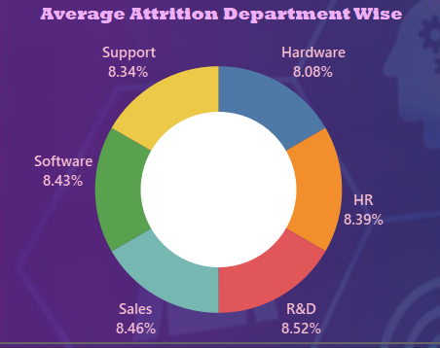
1
ATTRITION BY DEPARTMENT
In this sheet, we are going to analyse the attrition with respect to the department. The dataset has six departments.
This analysis can help us know which department has flaws and the department managers can further take measures to improve their employee satisfaction.
Findings : The Donut chart shows that the department of Research & Development has the highest attrition rate with 8.52% of total
attrition in the company, followed by Sales department with 8.46% and the Software with 8.43%, Support with 8.34% , HR with 8.39% and the least is in Hardware with 8.08%.

Slide 5
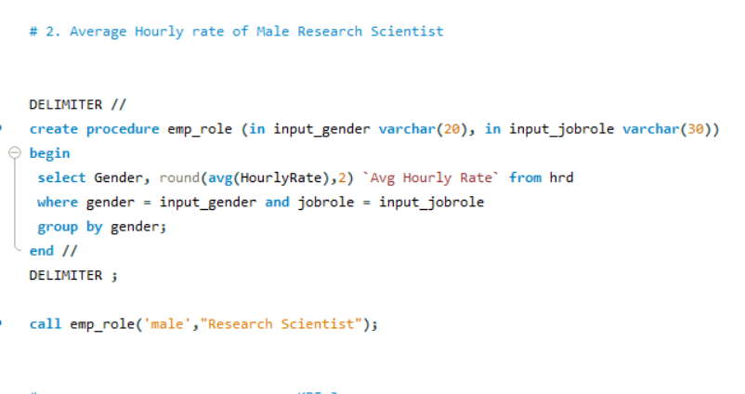
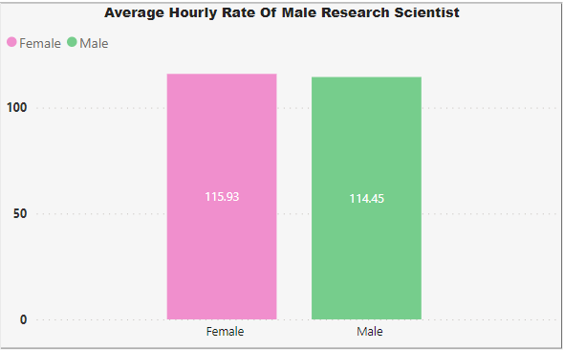
2
Average Hourly rate of Male Research Scientist
➢ THE INSIGHTS DRIVEN USING MYSQL IS SHOWN HERE AND VISUAL BY BI:
➢ MIN HOURLY RATE = 30
➢ MAX HOURLY RATE = 200
➢ AVG HOURLY RATE OF MALE RESEARCH
SCIENTIST IS COMING AS 114.45
➢ WHILE FOR FEMALE ITS 115.9
➢ WORK LIFE BALANCE FOR RESEARCH SCIENTIST IS AVERAGE

Slide 6
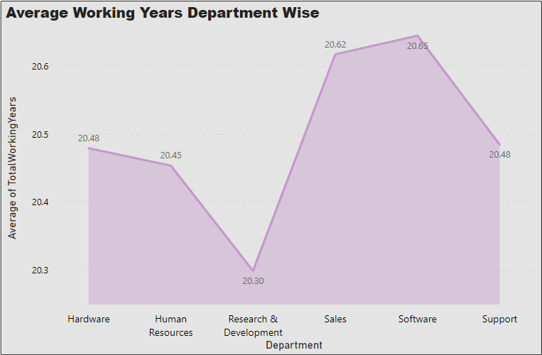
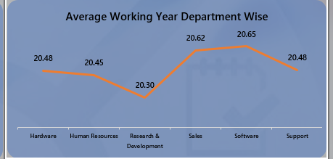
3
AVERAGE WORKING YEARS FOR EACH DEPARTMENT
The insights driven using Excel is shown here:
➢ Avg. working year for Software department is highest and for R&D department its lowest.
➢ But sales dept. has the lowest salary hike.
➢ We need to work on R&D dept

Slide 7
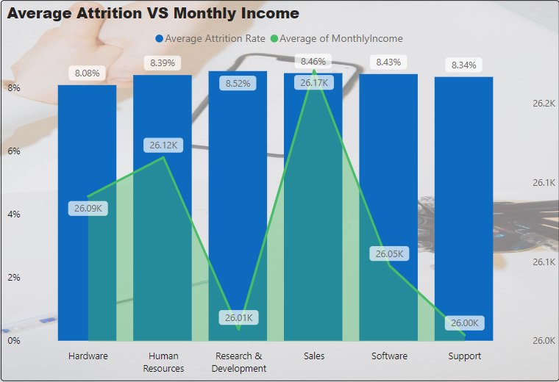
4
ATTRITION VS MONTHLY INCOME
A simple pay raise can boost morale, increase employee satisfaction, encourage hard work, and prevent attrition of talented employees.
If the management consistently rewards good performance, it will strengthen their relationship with their best employees
and also encourage average employees to improve. Offering salaries lower than the market will surely result in voluntary resignation,
leading to staff attrition
Findings : The insights driven using power bi is shown here :
➢ Min salary =26.00k
➢ Max salary = 26.17k .
➢ Max attrition is from 8.52%.
➢ That may be because they are getting better salary option in other company for the same work

Slide 8
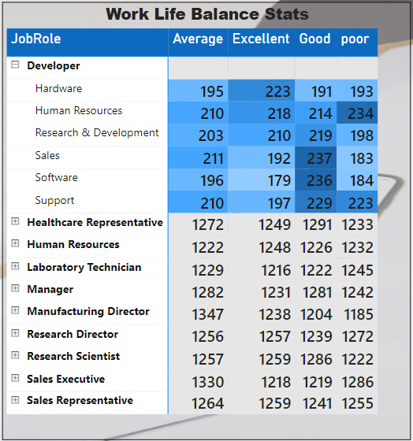
5
Job Role Vs Work life balance
The insights driven using Power Bi is shown here:
➢ We can see that Laboratory technician and research director are having excellent work life balance.
➢ While HR is having poor work life balance.
➢ Employees from HR department are not getting promotion frequently and they are getting less monthly income

Slide 9
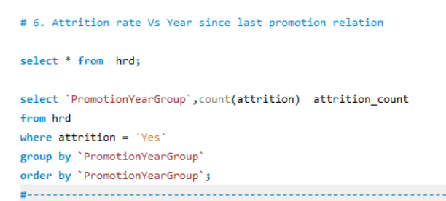
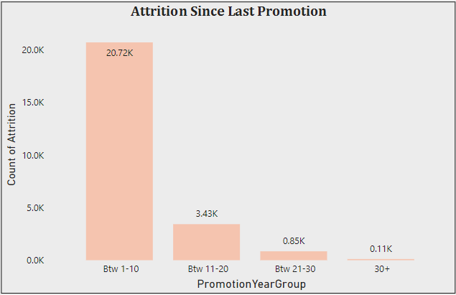
6
ATTRITION RATE VS YEAR SINCE LAST PROMOTION RELATION.
The Insights Driven Using Sql Is Shown Here And Data visualization by BI:
This Sheet Represents The Attrition With Respect To The Years Since The Last Promotion. Promotion Improves The Ambition Of Employees And Boosts Their Passion.
The Policy Of Filling Vacancies Through Internal Recruitment And Promotions Reduces The Attrition Rate, As It
Creates A Positive Environment In The Organization. Thus, Enhancing The Commitment And Confidence Of The Employee To Stay On.
➢ While The Employees Who Have Not Got Promoted For More Than 20 Years They Shows More Fluctuation In Attrition Graph.

Slide 10

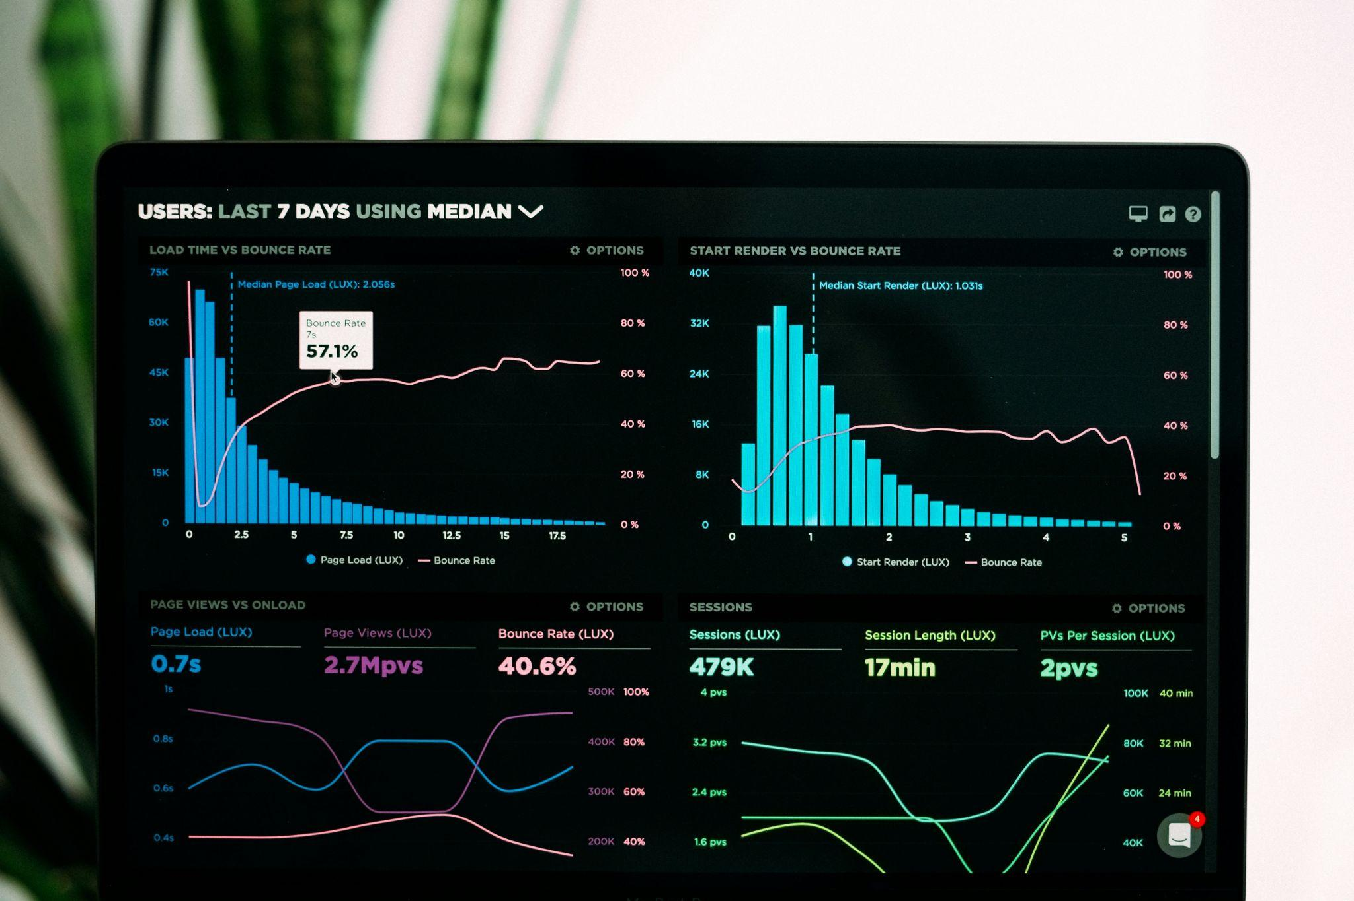
Conclusion and Key Takeaways
﻿The main objective of the organization is to earn profit and to earn profit the employer should concentrate in retaining talents and concentrate in making them stick to the organization for the long run. Employees are the assets of the organization.
Hence it is important for the employers to minimize the attrition rate and help in both individual as well as organizational growth. Thus, Organizations should create an environment that fosters ample growth opportunities, appreciation for the work accomplished and a friendly cooperative atmosphere that makes an employee feel connected to every respect to the organization.
Retention plans are an inexpensive way of enhancing workplace productivity and engaging employees emotionally . Proficient employees keep the quality up and business operations run smoothly along with the cost saving in the longer run.

Slide 11
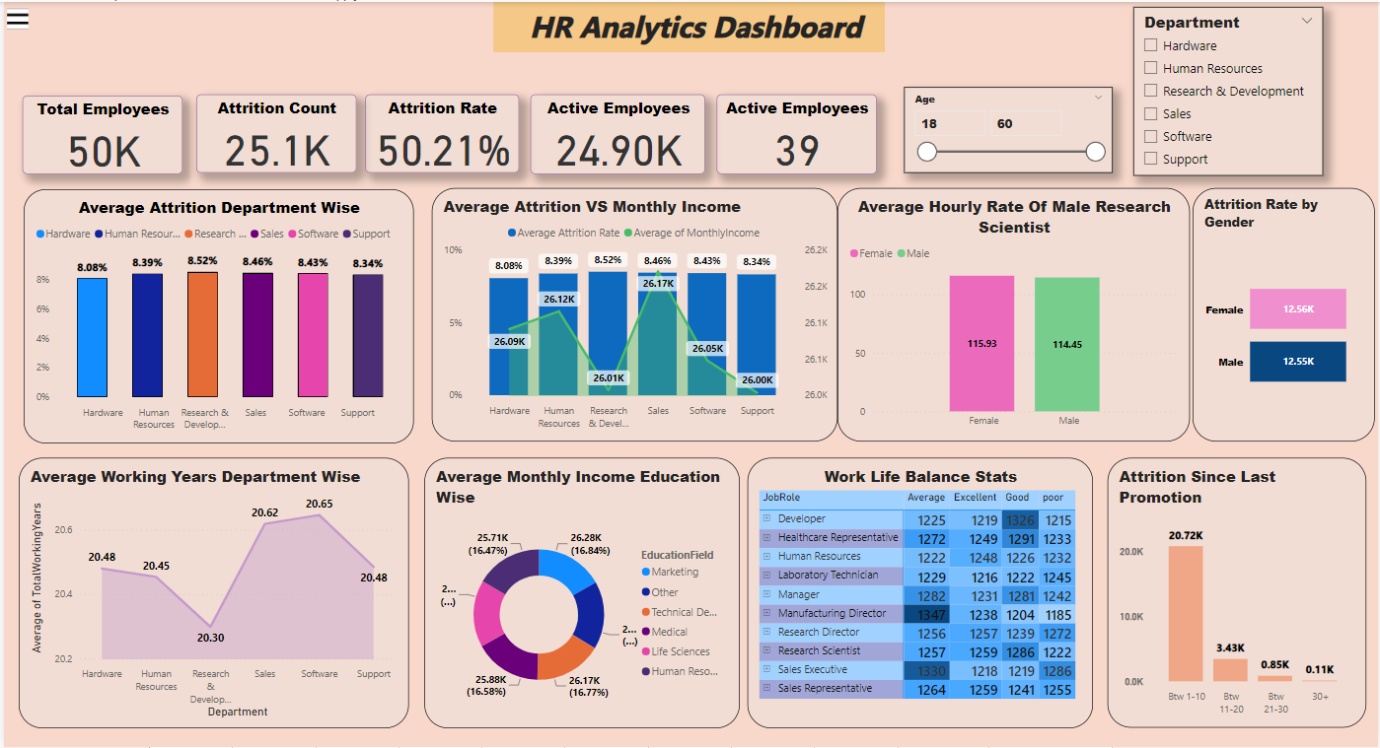
Dashboard
Power BI Dashboards provide a visual representation of data for better decision making to HR Dept.
They offer numerous benefits, including enhanced insights and increased efficiency.
Key elements of a dashboard include visualizations HR Data, widgets, and filters.
There are different types of dashboards, such as operational, strategic, analytical, and executive Hr dept.

Slide 12

Thank you

